Slide 1
Final Engagement
Attack, Defense & Analysis of a Vulnerable Network
Part 1: Attack

Slide 2
Table of Contents
This section contains the following resources:
Network Topology & Critical Vulnerabilities
Exploits Used
Avoiding Detect
Maintaining Access

Slide 3

Network Topology
& Critical Vulnerabilities

Slide 4
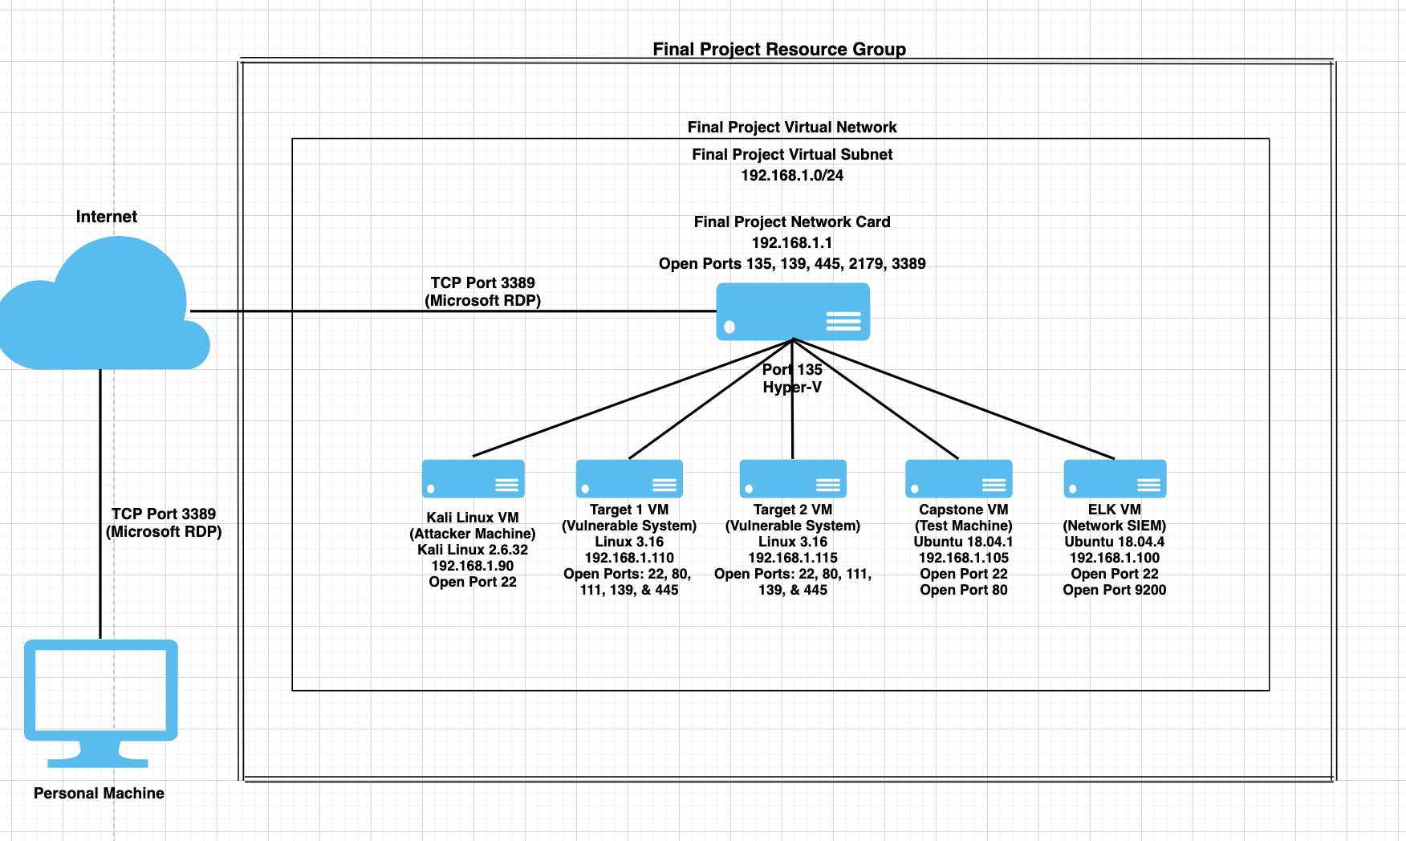
Network Topology
Network
Address Range: 192.168.1.0/24
Netmask: 255.255.255.0
Gateway: 192.168.1.1
Machines
IPv4: 192.168.1.90
OS: Kali Linux 5.4.0
Hostname: Kali
IPv4: 192.168.1.100
OS: Ubuntu Linux 18.04.1
Hostname: ELK
IPv4: 192.168.1.105
OS: Ubuntu Linux 18.04.1
Hostname: Capstone
IPv4: 192.168.1.110
OS: Linux 3.16
Hostname: Target 1
IPv4: 192.168.1.115
OS: Linux 3.16
Hostname: Target 2

Slide 5
Critical Vulnerabilities: Target 1
Our assessment uncovered the following critical vulnerabilities in Target 1.
Vulnerability | Description | Impact
Open/Unfiltered TCP Ports 80 & 22 | Unsecured ports serve as potential attack vectors, such as connecting via SSH. | High
Misconfigured File Privileges | Improper user permissions can be exploited to gain access to sensitive data. | High
Brute Force Attack | Simple passwords are easily cracked by high volume login attempts. | High
Privilege Escalation | Improper user permissions can be exploited to gain root access. | Severe

Slide 6
Critical Vulnerabilities: Target 2
Our assessment uncovered the following critical vulnerabilities in Target 2.
Vulnerability | Description | Impact
Open/Unfiltered TCP Ports 22 & 80 | Unsecured ports serve as potential attack vectors, such as connecting via SSH | High
Web Object Enumeration | Susceptible to exposure of sensitive directories stored on the web server | High
PHP File Upload | Susceptible to malicious payloads via remote file upload | Severe
Remote Command Injection | Attackers can run any command on the target system remotely (eg. cat /etc/passwd) | Severe

Slide 7
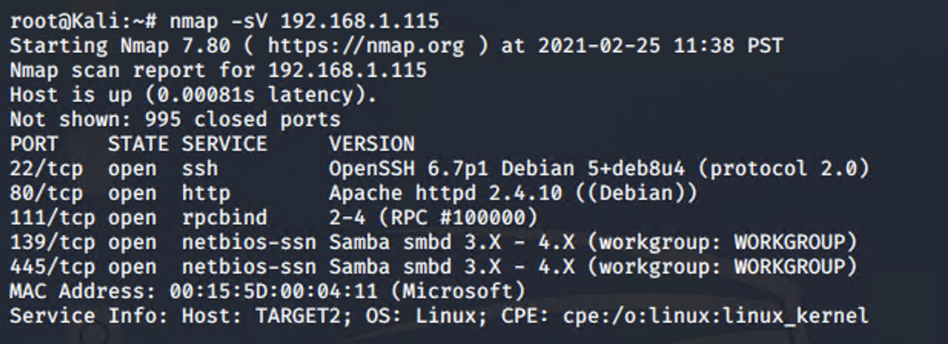
Exploitation: Open/Unfiltered TCP Ports 22 & 80
Tools: Nmap
Result: Additional attack vectors
Step 1: Nmap Scan (Service Versions Included)

Slide 8
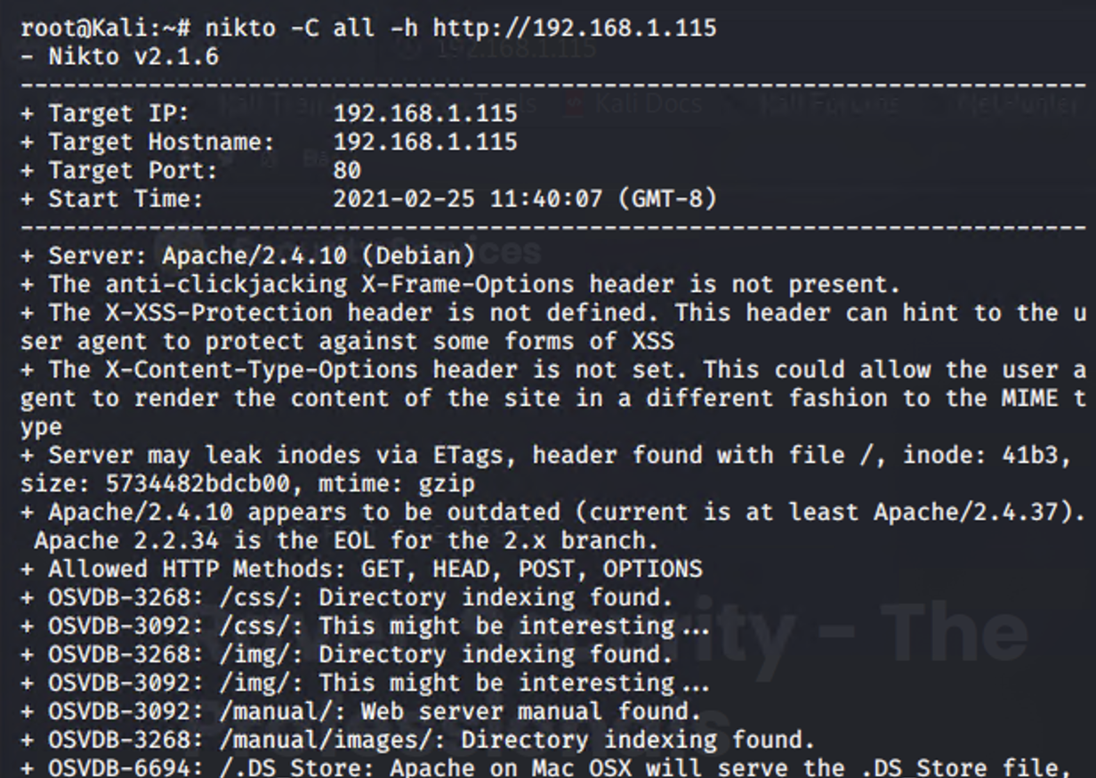
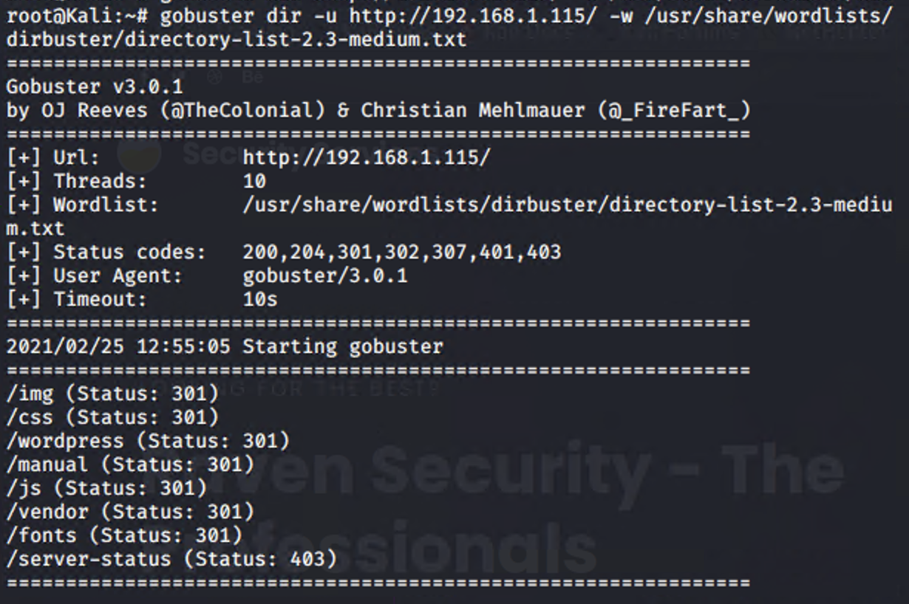
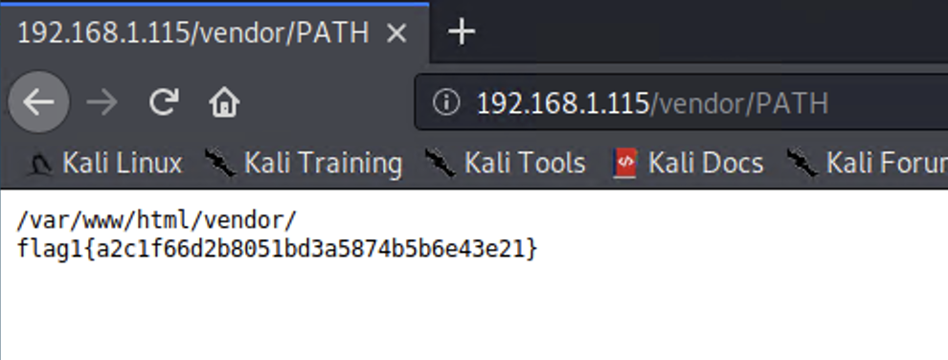
Exploitation: Web Object Enumeration
Tools: Nikto, gobuster
Result: Access to sensitive directories
Step 1: Nikto Scan
Step 2: Gobuster Scan (More In-Depth Enumeration)
Step 3: Obtain Flag 1

Slide 9
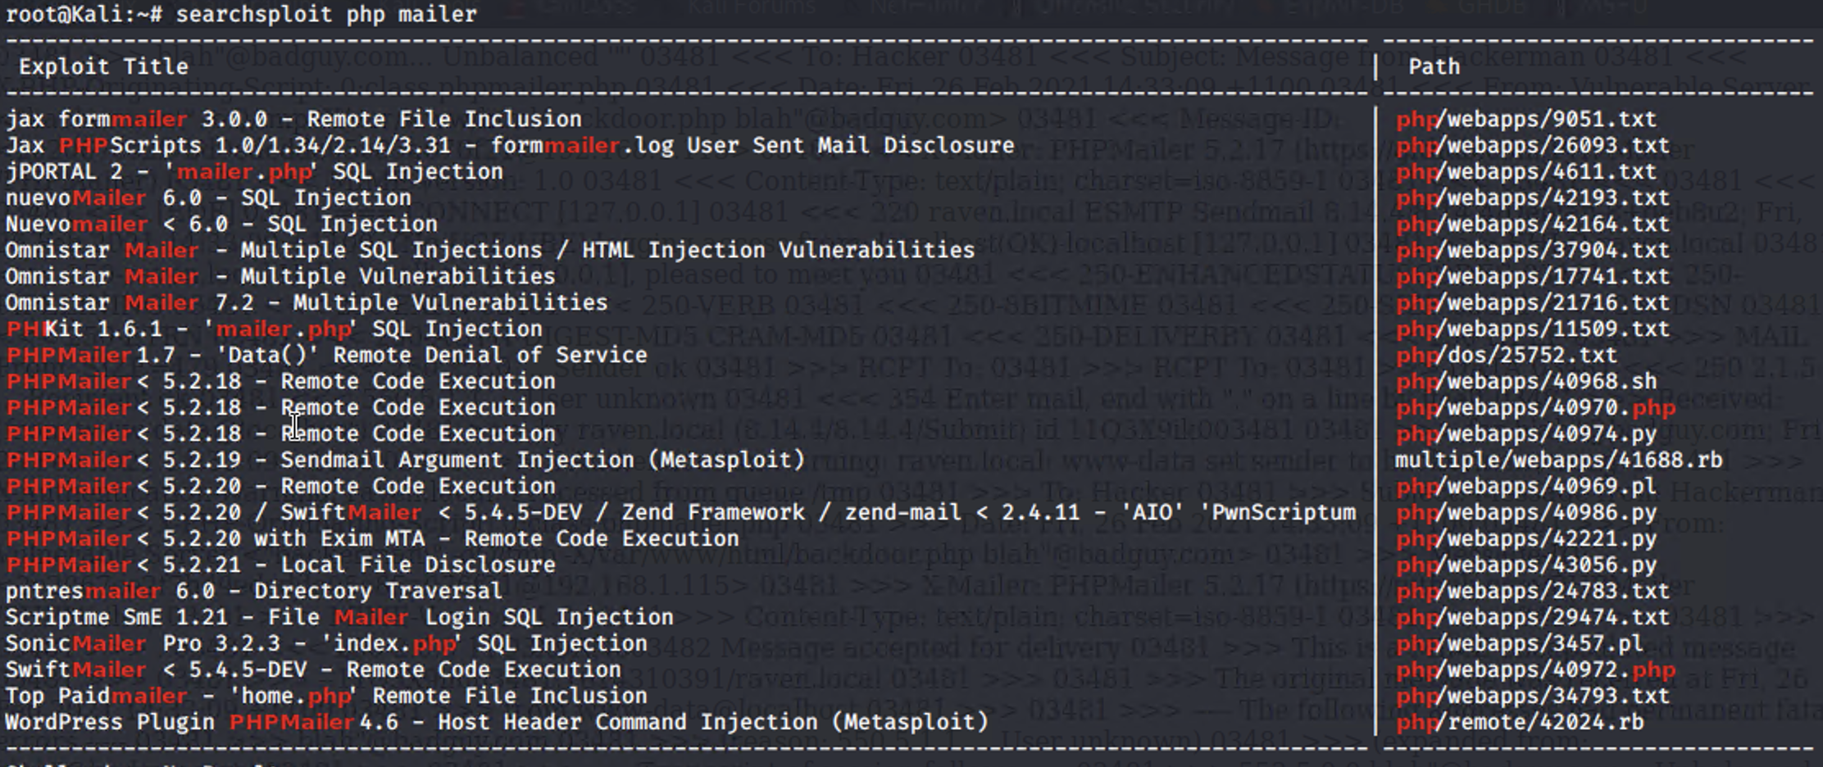
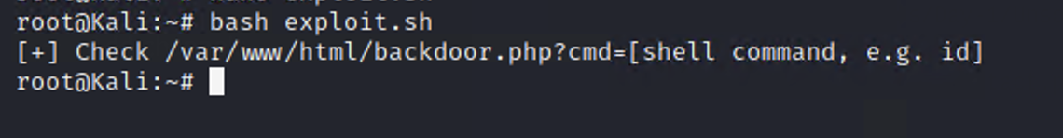
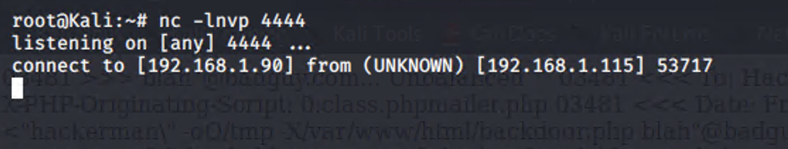
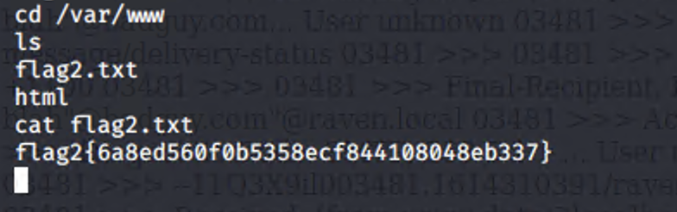
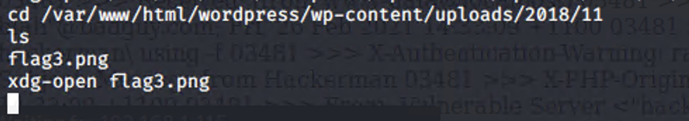
Exploitation: PHP File Upload & Remote Command Injection
Tools: Searchsploit, exploit.sh script, ncat
Result: Reverse shell on the target system, Flags 2 & 3
Step 1: Searchsploit Query
Step 2: PHP File Upload
Step 3: Secure Reverse Shell
Step 4: Obtain Flags 2 & 3

Slide 10
Exploits Used

Slide 11
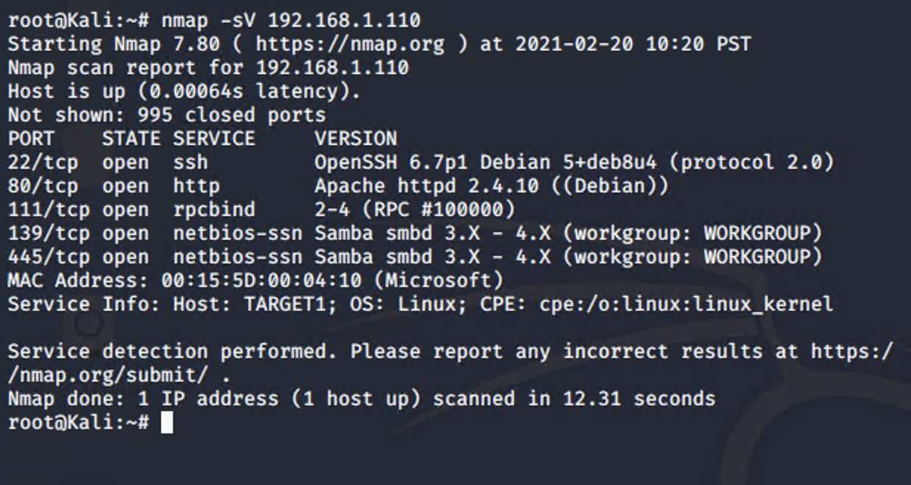
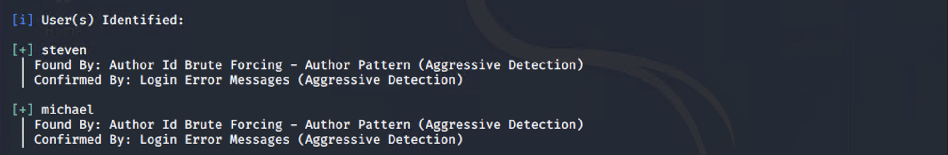
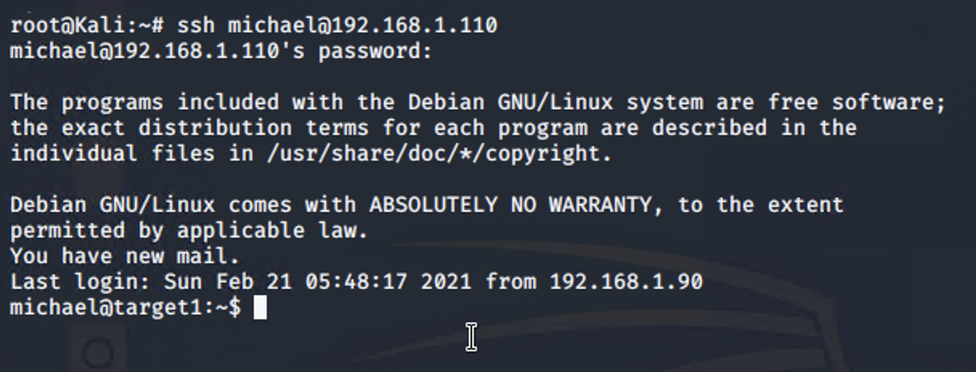
Target 1 Exploitation: Open/Unfiltered Ports 22 & 80, Weak User Credentials
Tools: Nmap, WPScan, SSH Login
Result: User shell
Step 1: Nmap Scan (Service Versions Included)
Step 2: WPScan User Enumeration
Step 3: Secure User Shell with SSH

Slide 12
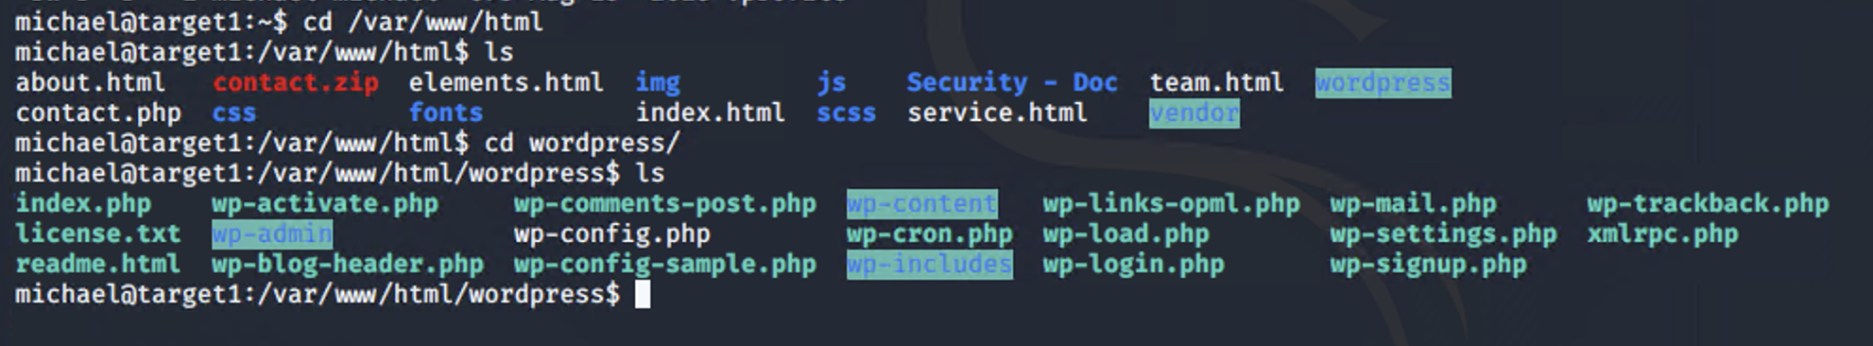
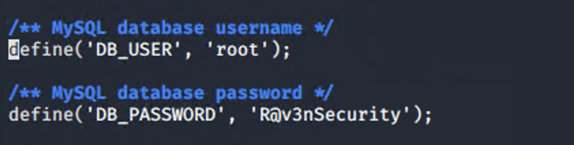
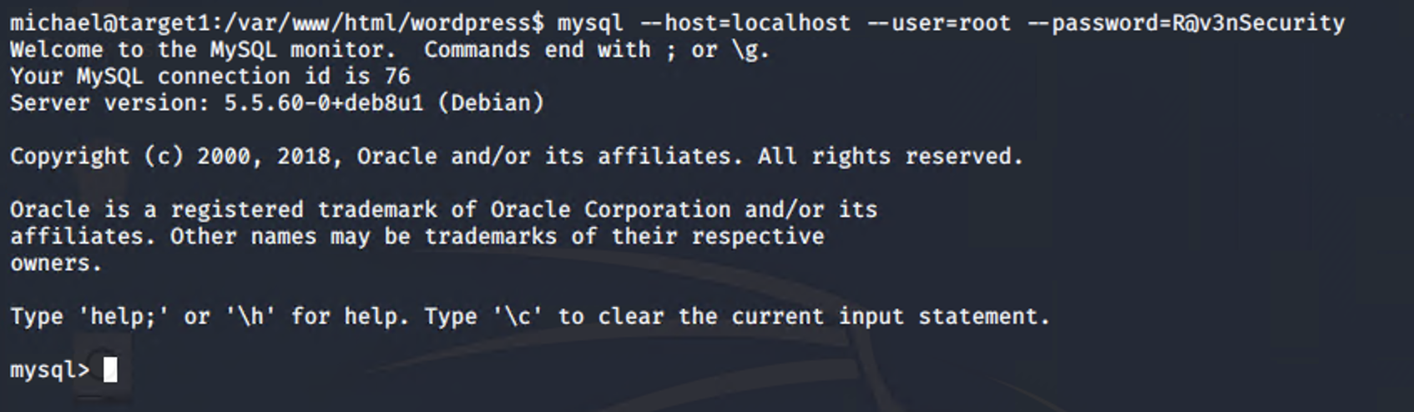
Target 1 Exploitation: Misconfigured File Privileges
Tools: File system traversal
Result: Web server database access
Step 1: File System Traversal
Step 2: wp-config.php Access | Enumeration of MySQL Credentials
Step 3: MySQL Database Access

Slide 13
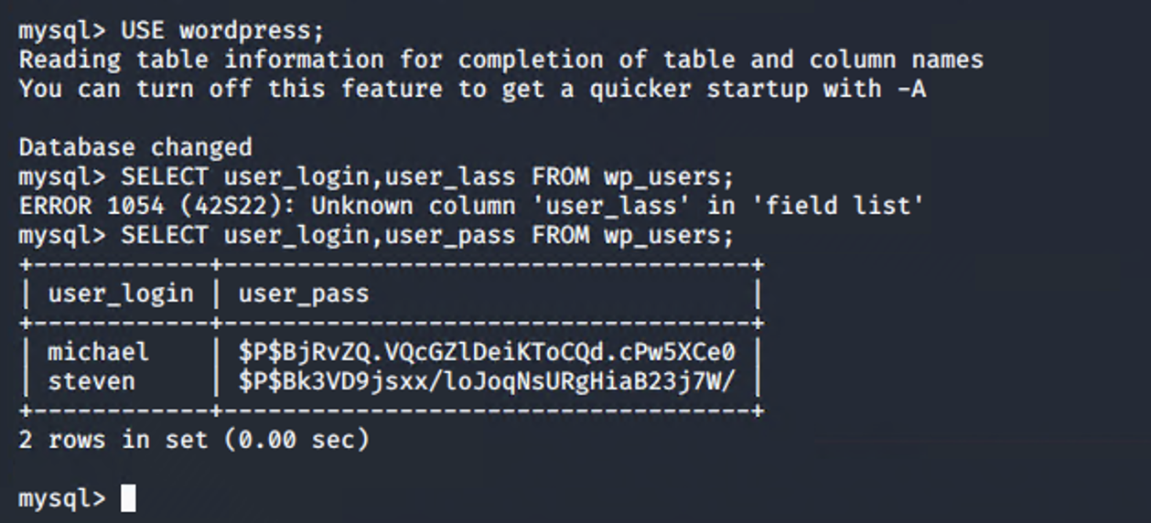
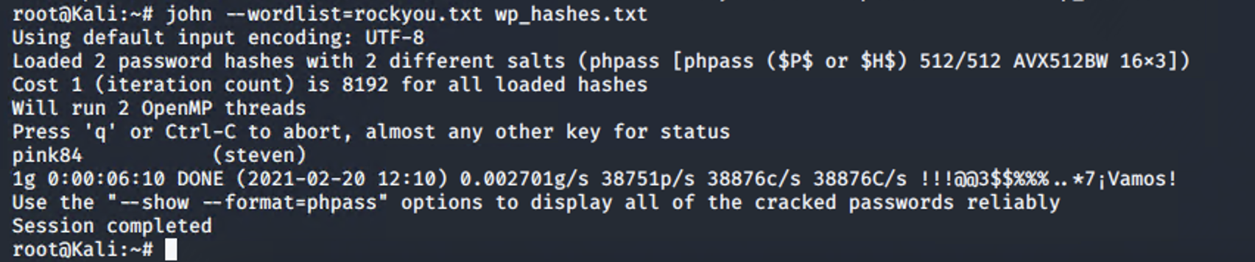
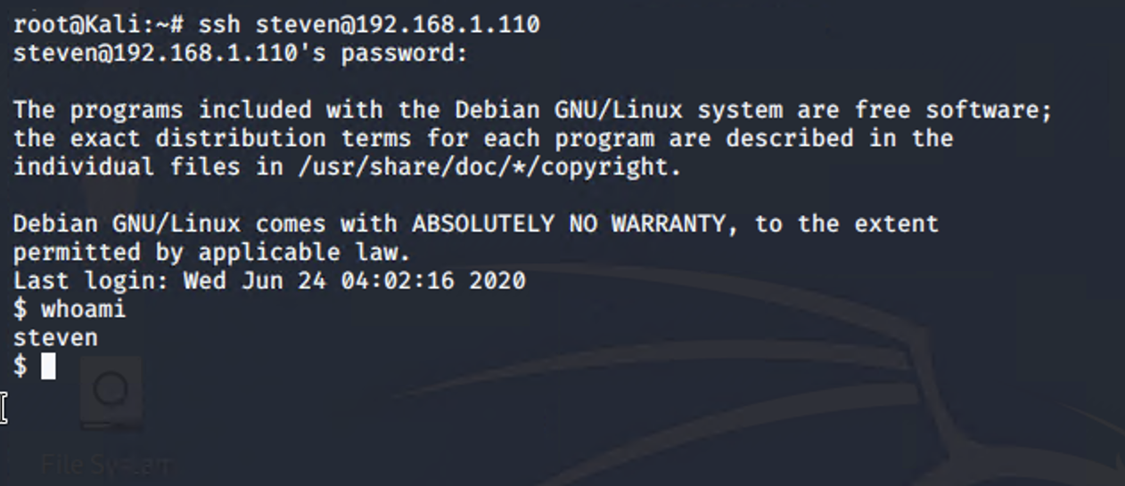
Target 1 Exploitation: Brute Force Password Guessing
Tools: John the Ripper, SSH Login
Result: User shell with sudo privileges
Step 1: Obtain MySQL User Password Hashes
Step 2: Password Cracking
Step 3: Secure User Shell with SSH

Slide 14
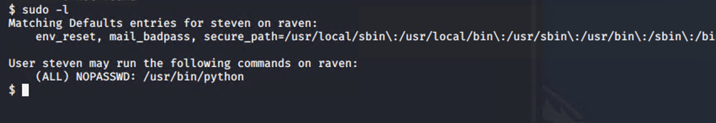
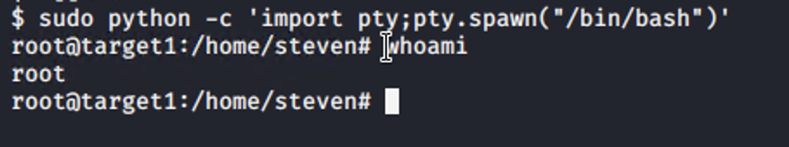
Target 1 Exploitation: Privilege Escalation
Tools: Command Line
Result: Root access
Step 1: Sudo Privileges Check
Step 2: Privilege Escalation

Slide 15
Target 2 Exploitation: Open/Unfiltered TCP Ports 22 & 80
Tools: Nmap
Result: Additional attack vectors
Step 1: Nmap Scan (Service Versions Included)

Slide 16
Target 2 Exploitation: Web Object Enumeration
Tools: Nikto, gobuster
Result: Access to sensitive directories
Step 1: Nikto Scan
Step 2: Gobuster Scan (More In-Depth Enumeration)
Step 3: Obtain Flag 1

Slide 17
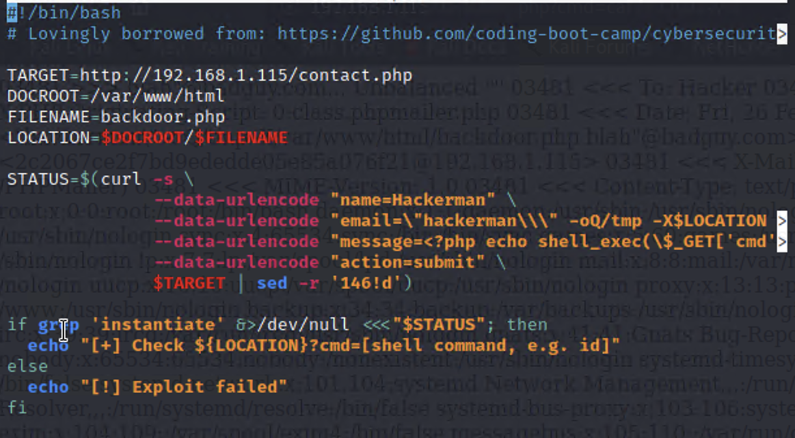
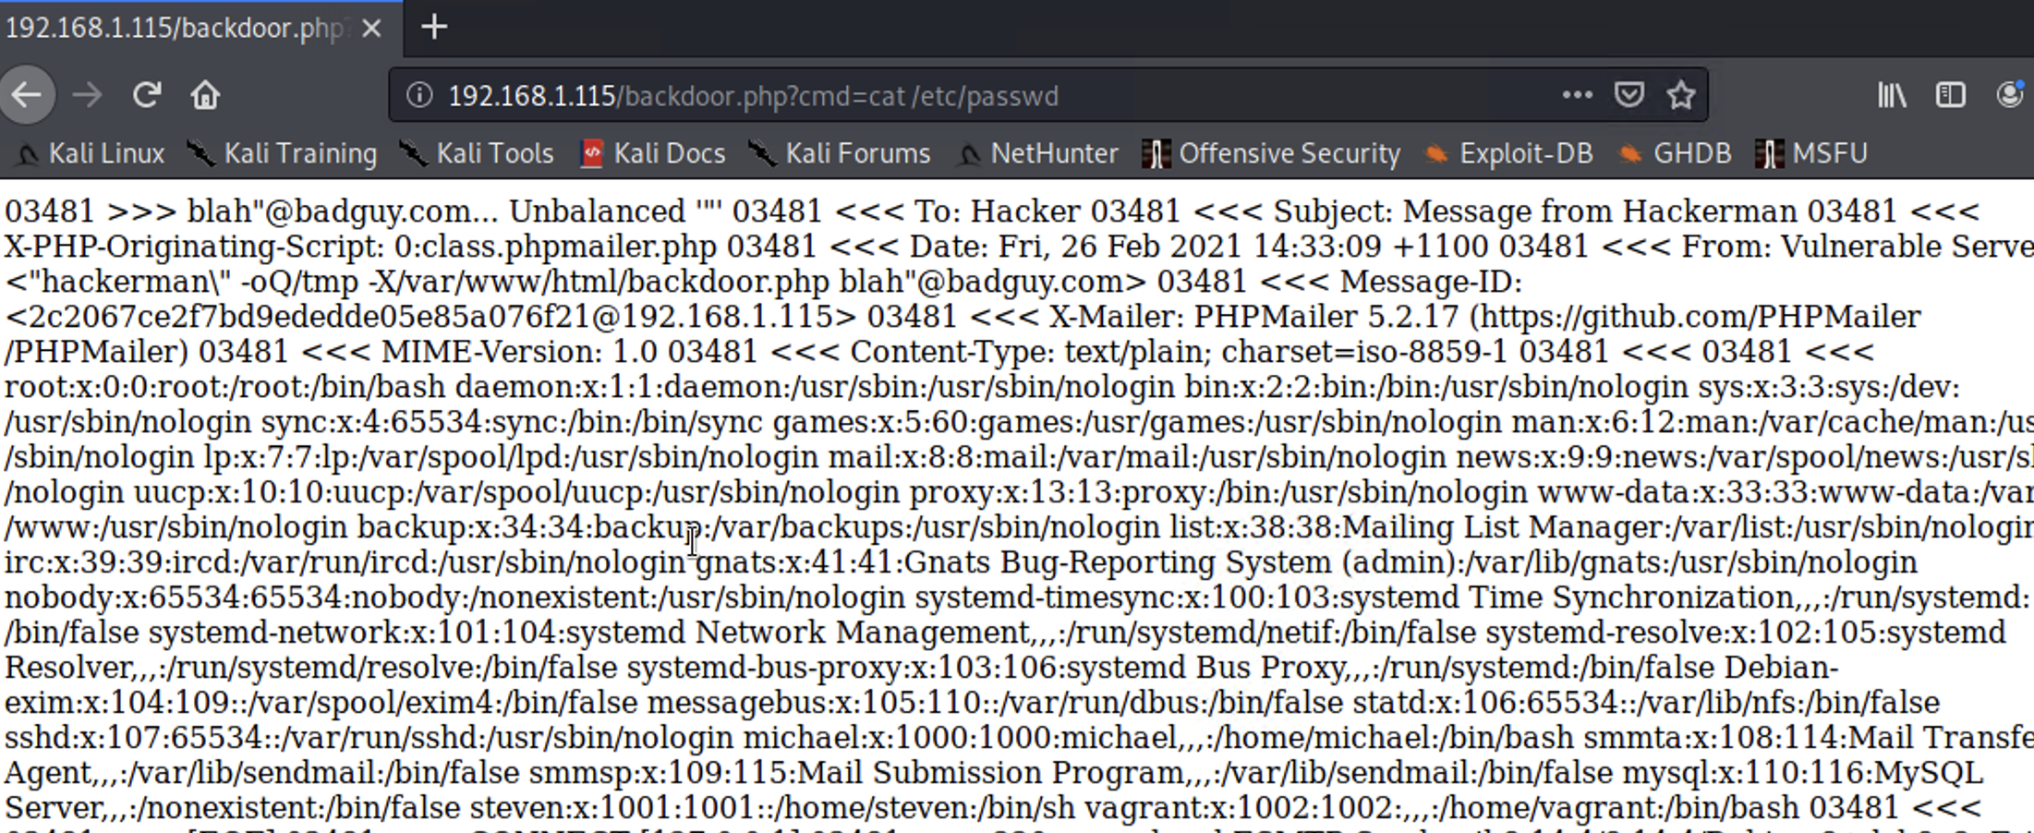
Target 2 Exploitation: PHP File Upload & Remote Command Injection, Pt. 1
Tools: Searchsploit, PHP file upload via exploit.sh script
Result: Access to sensitive directories
Step 1: Searchsploit Query
Step 2: PHP File Upload
Step 3: /etc/password Dump

Slide 18
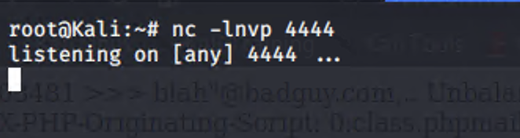
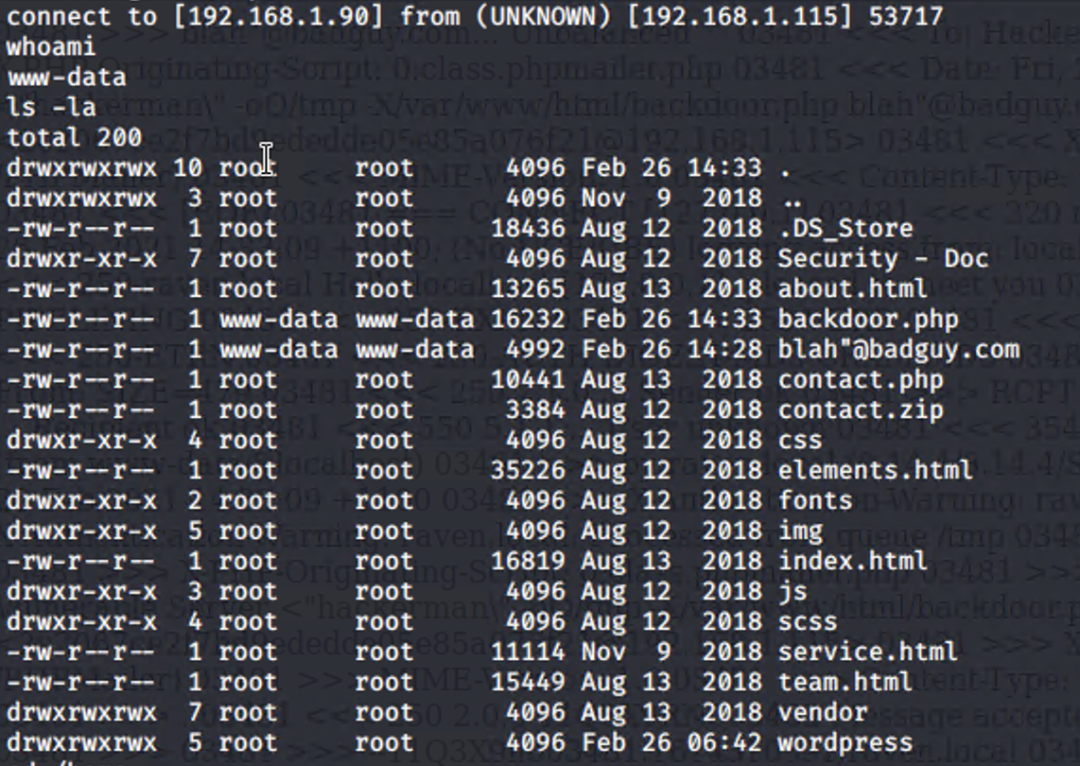
Target 2 Exploitation: PHP File Upload & Remote Command Injection, Pt. 2
Tools: ncat
Result: Reverse shell on the target system, Flags 2 & 3
Step 1: Open Listener on Host
Step 2: Open Listener on Target
Step 3: Secure User Shell on Target
Step 4: Obtain Flags 2 & 3

Slide 19
Avoiding Detection

Slide 20
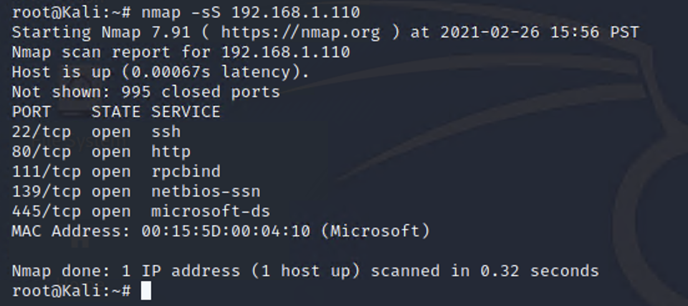
Target 1: Stealth Exploitation of Open/Unfiltered TCP Ports 80 & 22
Monitoring Overview
Alert: Port Scan
Metrics: TCP SYN packets
Threshold: >500 from 1 IP in 30 sec
Mitigating Detection
To scan without triggering this alert, run nmap -sS <IP address>

Slide 21
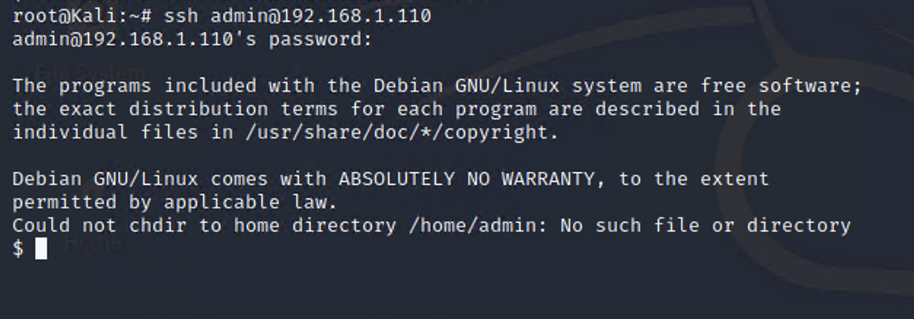
Target 1: Stealth Exploitation of Misconfigured File Privileges
Monitoring Overview
Alert: Protected Directory Monitoring
Metrics: Read/Write/Execute events on protected directories from unprivileged users
Thresholds: >1 Read/Write/Execute event from unprivileged user
Mitigating Detection
Avoid detection by compromising more privileged user accounts

Slide 22
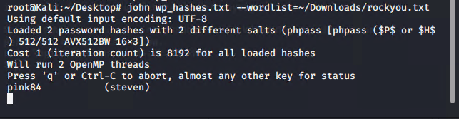
Target 1: Stealth Exploitation of Brute Force Attack
Monitoring Overview
Alerts: An alert can be set to monitor HTTP 400 response codes, but they would fail to notice the local brute force attack used to crack the users’ hashes.
Metrics: HTTP 400 range response codes.
Threshold: 10 failed login attempts in 30 seconds.
Mitigating Detection
Passwords were easily guessed and hashes were stored in a text document. Hashes were copied and cracked locally, so no alerts were triggered.

Slide 23
Target 1: Stealth Exploitation of Privilege Escalation
Monitoring Overview
Alert: Sudo Usage
Metrics: Any user not in sudoers file or sudo group running sudo commands
Threshold: >1 sudo event from non-sudo user
Mitigating Detection
If the alert is properly configured, any sudo usage should be detected.
Logging in as a user who regularly performs actions at root could be a way to circumvent this alert, though this could easily be prevented with strong security culture.

Slide 24
Target 2: Stealth Exploitation of Open/Unfiltered TCP Ports 80 & 22
Monitoring Overview
Alert: Port Scan
Metrics: TCP SYN packets
Threshold: >500 from 1 IP in 30 sec
Mitigating Detection
To scan without triggering this alert, run nmap -sS <IP address>

Slide 25
Target 2: Stealth Exploitation of Web Object Enumeration
Monitoring Overview
Alert: Excessive HTTP 400 Status Codes
Metrics: HTTP 400-Class Response Codes
Threshold: >10 400-Class status codes in 30 seconds
Mitigating Detection
Use a quieter web server scanner tool, such as… (TBD)

Slide 26
Target 1: Stealth Exploitation of PHP File Upload
Monitoring Overview
Alert: PHP File Upload
Metrics: Events: HTTP POST Requests containing file names ending in .php in request body
Threshold: >1 event
Mitigating Detection
Avoid this alert by changing arbitrary file extension from “.php” to something else, such as “.jpg”

Slide 27
Target 1: Stealth Exploitation of Remote Command Injection
Monitoring Overview
Alert: Malicious URL Activity
Metrics: POST Requests with url parameters containing “*cmd=*”
Threshold: >=1 event
Mitigating Detection
TBD

Slide 28
Maintaining Access

Slide 29
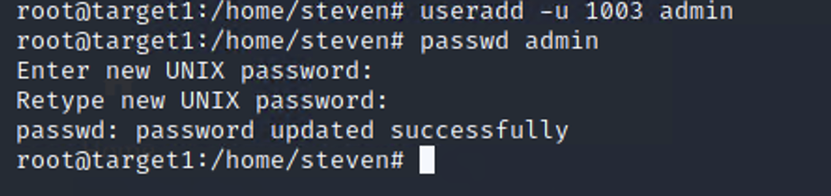
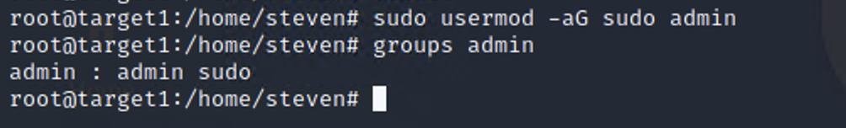
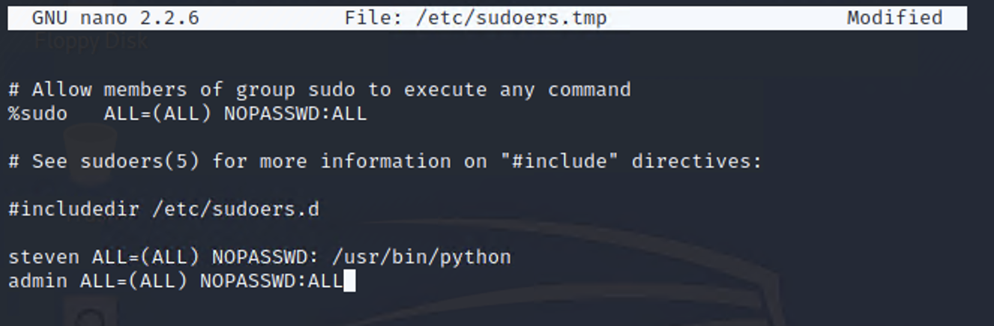
Backdooring Target 1
Backdoor Overview
Backdoor Type: Shadow user
Implementation: Created user “Admin” on the target system as root
Connection: SSH Login
Step 1: User Account Creation
Step 2: Add User to Sudo Group
Step 4: Login Verification
Step 3: Reconfigure Sudoers File (Redundancy)

Slide 30
Backdooring Target 2
Backdoor Overview
Backdoor Type: Reverse Shell
Implementation: PHP file upload to target web server via malicious script
Connection: Ncat listener
Step 1: PHP File Upload
Step 2: Open Listener on Host & Target
Step 3: Secure User Shell on Target

Slide 31
Final Engagement
Attack, Defense & Analysis of a Vulnerable Network
Part 2: Defense

Slide 32
Table of Contents
This section contains the following resources:
Network Topology & Critical Vulnerabilities
Alerts Implemented
Hardening
Implementing Patches

Slide 33

Notes:
TB

Slide 34
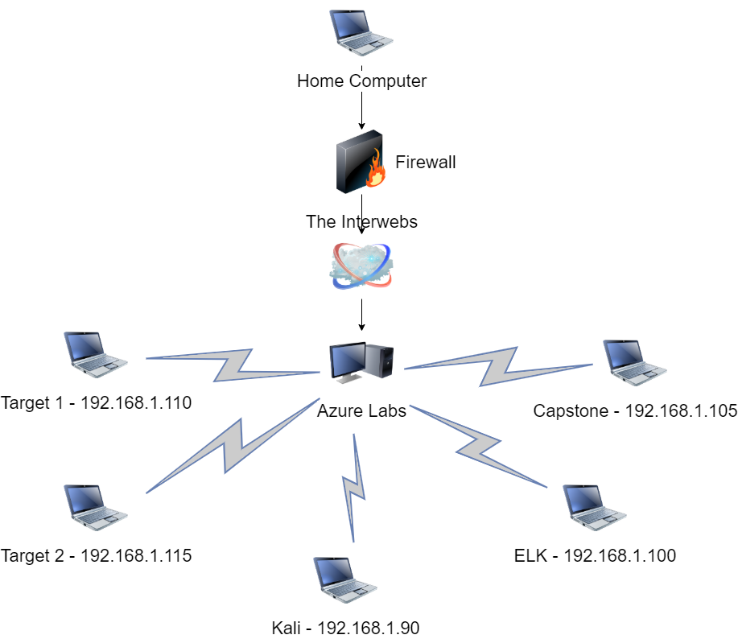
Notes:
TB

Slide 35
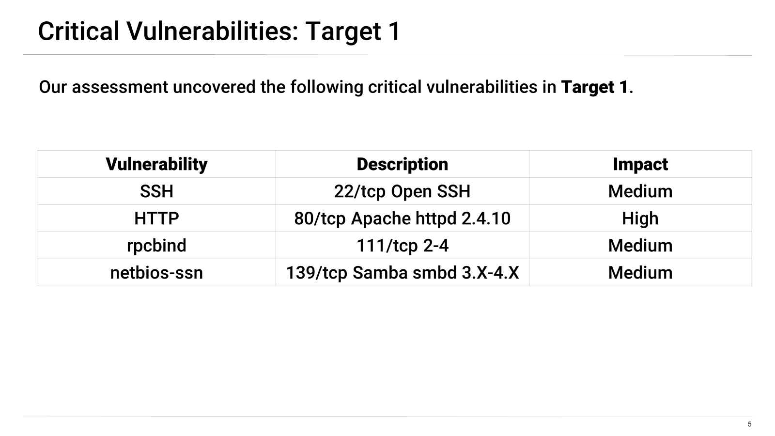
Notes:
TB

Slide 36
Alerts Implemented
Notes:
DF

Slide 37
Excessive HTTP Errors
Summarize the following:
Which metric does this alert monitor?
By count
What is the threshold it fires at?
400 + within 5 minutes from top 5 HTTP response status codes
Provide a screenshot of the alert in action.
Notes:
DF

Slide 38
HTTP Request Size Monitor
Summarize the following:
Which metric does this alert monitor?
Sum
What is the threshold it fires at?
HTTP request bytes over all documents is over 3500 within 1 minute
Provide a screenshot of the alert in action.
Notes:
TB

Slide 39
CPU Usage Monitor
Summarize the following:
Which metric does this alert monitor?
Max
What is the threshold it fires at?
CPU total utilization over all documents is about 50 percent for 5 minutes
Provide a screenshot of the alert in action.
Notes:
TB

Slide 40
Hardening
Notes:
DF

Slide 41
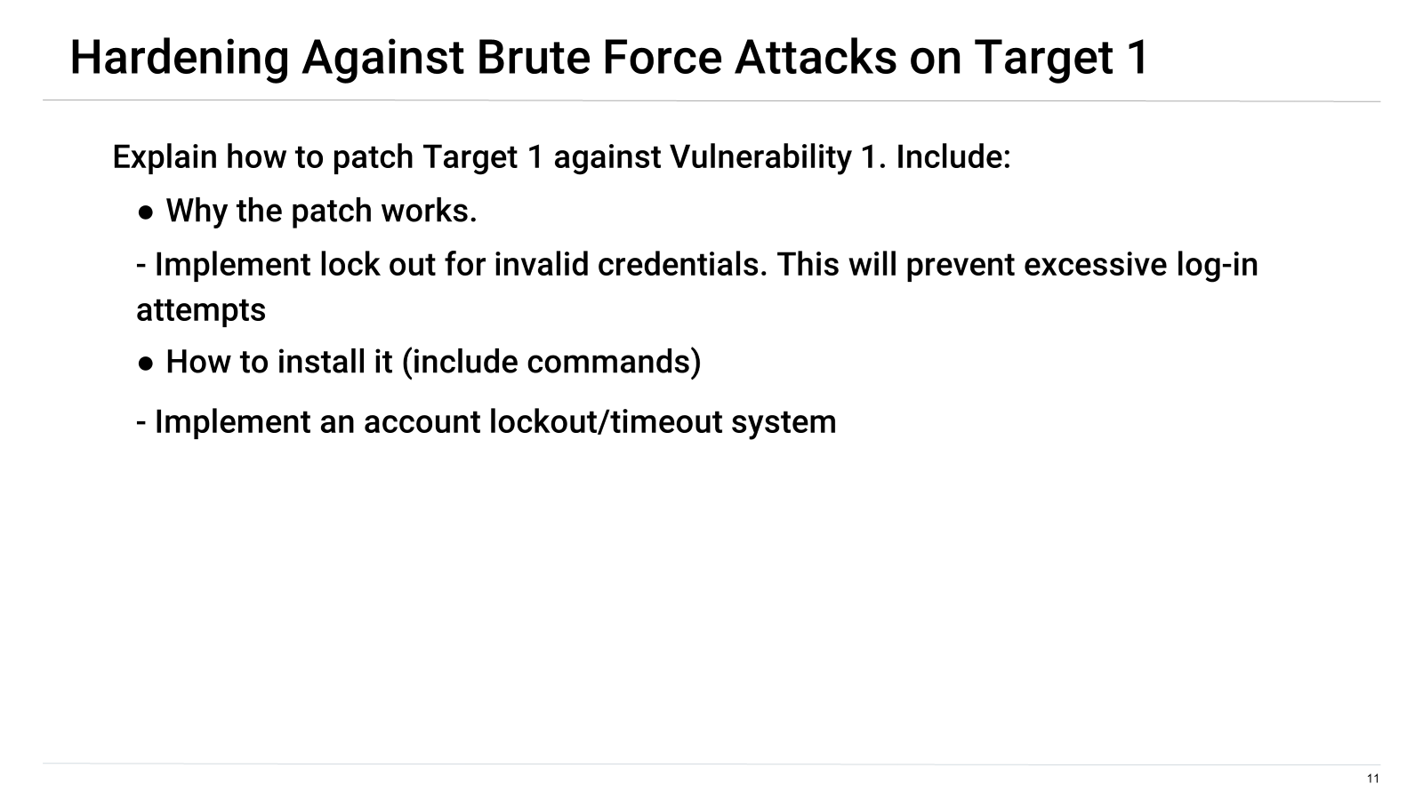
Notes:
DF

Slide 42
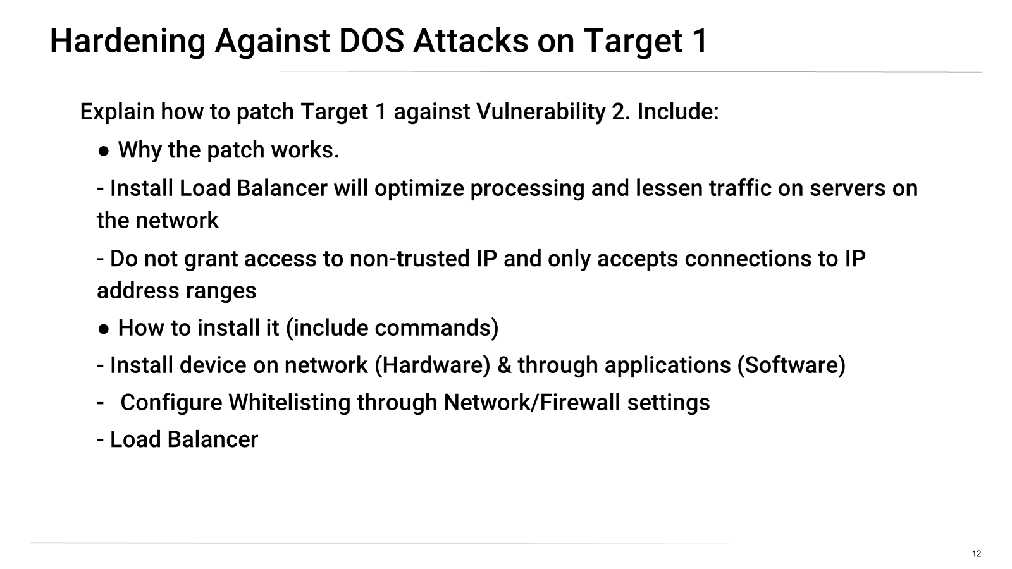
Notes:
DF

Slide 43
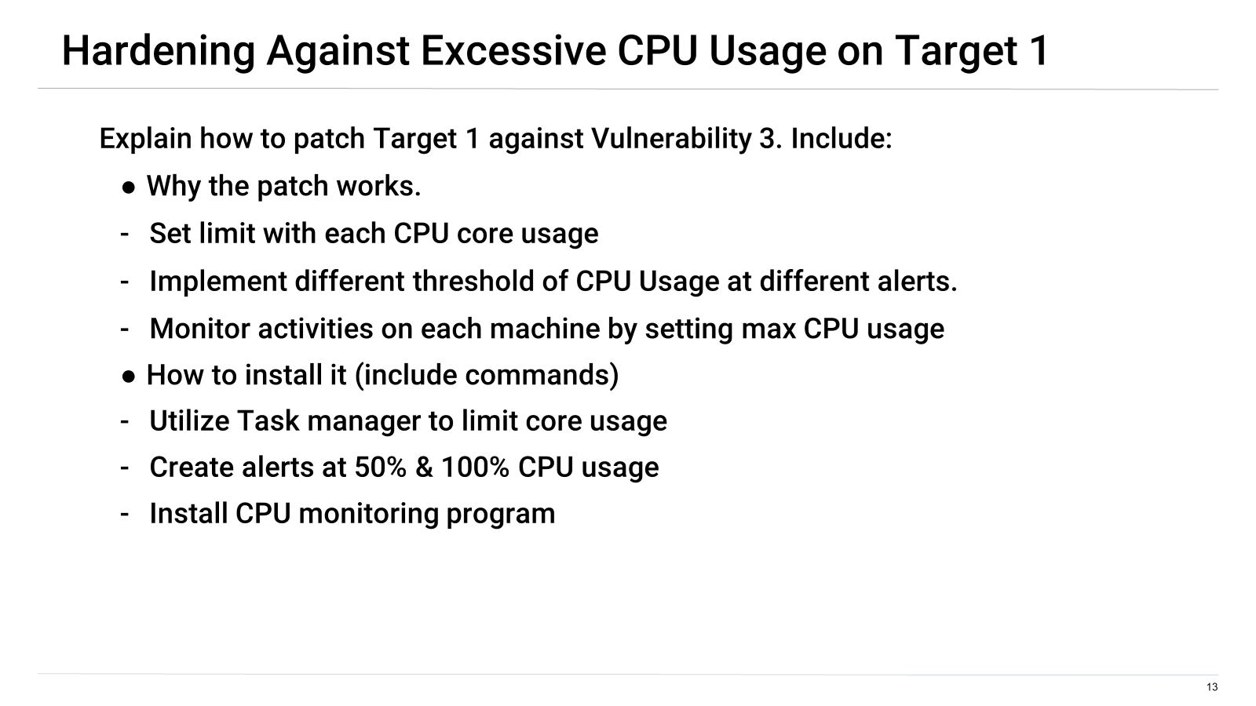
Notes:
DF

Slide 44
Hardening Against [SSH password usage] on Target 1
-SSH using simple passwords is never a good idea. Instead it would be better to use SSH key pair:
-There would no longer be an ability to Brute force password access to remote server.
-Requires use the “ssh-keygen” command followed by “ssh-copy-id” to copy key.
-Disable password login for root account
Notes:
TB

Slide 45
Hardening Against HTTP on Target 1
-Remove server version banner and directory browser listing:
-This does not remove a vulnerability; this simply makes enumeration and vulnerability identification more difficult.
-Banner removal: edit /etc/apache2/httpd.conf
-Server Tokens >>> Prod
-ServerSigniture >>> Off
-Disable browser listing: edit /etc/httpd/conf/httpd.conf
-Find line: Options Indexes FollowSymLinks >>> remove “indexes”
Notes:
TB

Slide 46
Hardening Against Samba SMBD on Target 1
-Use host-based Protection and IPC$ share deny:
-Allowing remote connection from specific IP ranges prevents unauthorized access to hidden files on server.
-IPC$ share deny prevents remote users from seeing what shares are available on the server via named pipes essential for communication between programs.
Notes:
DF

Slide 47


Slide 48
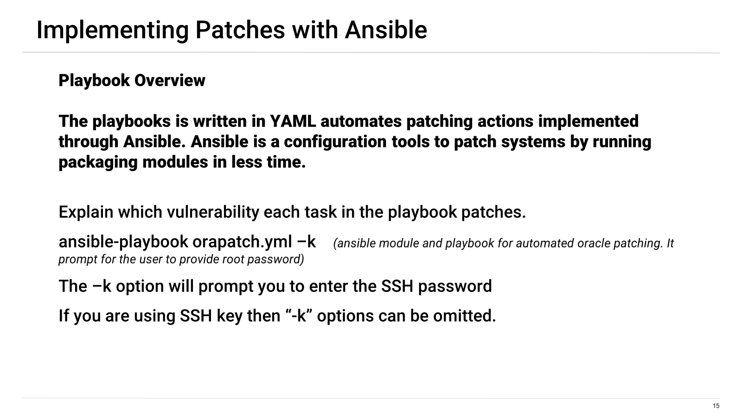
Notes:
DF

Slide 49
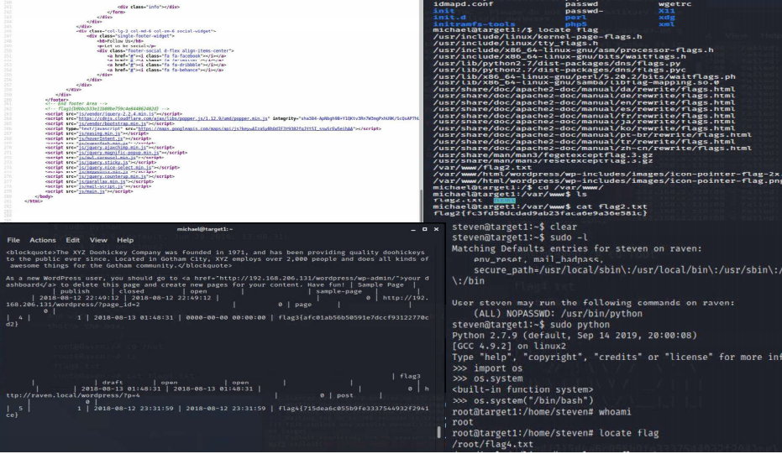
Notes:
TB

Slide 50
Final Engagement
Attack, Defense & Analysis of a Vulnerable Network
Part 3: Network Analysis

Slide 51
Table of Contents
This document contains the following resources:
Network Topology & Critical Vulnerabilities
Traffic Profile
Normal Activity
Malicious Activity

Slide 52
Network Topology
& Critical Vulnerabilities

Slide 53
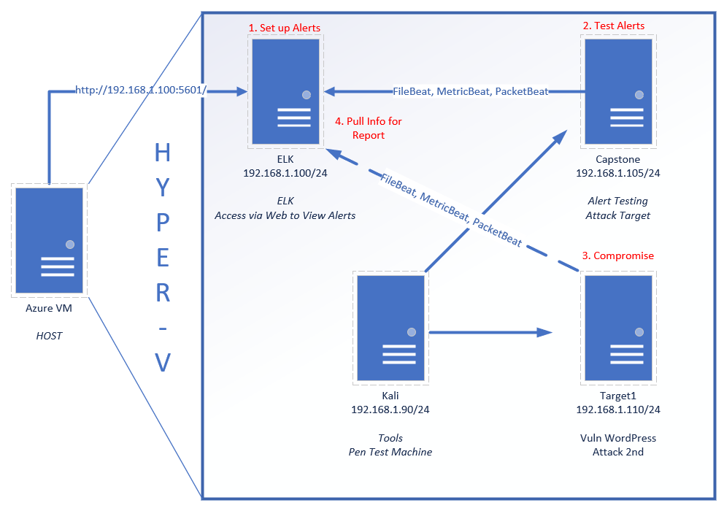
Network Topology
[
Network
Address Range: 192.168.1.97 - 192.168.1.110
Netmask: 255.255.240.0
Gateway: 10.0.0.1
Machines
IPv4: 192.167.1.110
OS:Linux
Hostname: Target1
IPv4:192.168.1.105
OS: Linux
Hostname: Capstone
IPv4:192.168.1.90
OS: Linux
Hostname: Kali
IPv4: 192.168.1.100
OS: Windows
Hostname: ELK

Slide 54
Critical Vulnerabilities: Target 1
Our assessment uncovered the following critical vulnerabilities in Target 1.
CVE-2018-15473 | User enumeration | OpenSSH through 7.7 is prone to a user enumeration vulnerability
CVE-2020-14145 | Man-in-the-middle | OpenSSH 5.7-8.4 has a discrepancy which can leak information allowing attackers to target initial connection attempts
CVE-2019-6111 | Malicious scp server or man-in-the-middle | Allows malicious actors to access and overwrite files via SSH
CVE-2018-15919 | User enumeration | Remote hackers can detect users on target system when GSS2 is in use

Slide 55
Traffic Profile

Slide 56
Traffic Profile
Our analysis identified the following characteristics of the traffic on the network:
Feature | Value | Description
Top Talkers (IP Addresses) | 185.243.115.84 <> 172.16.4.205 (26 M) 166.62.11.64 <> 172.16.4.205 (16 M) 10.0.0.201 <> 23.43.62.169 (7 K) | Machines that sent the most traffic.
Most Common Protocols | TCP, UDP, HTTP | Three most common protocols on the network.
# of Unique IP Addresses | 104,070 | Count of observed IP addresses.
Subnets |  | Observed subnet ranges.
# of Malware Species | 1 | Number of malware binaries identified in traffic.
Notes:
You may have more than 2 subnets.

Slide 57
Behavioral Analysis
Users were observed engaging in the following kinds of activity.
“Normal” Activity
Social Media
  Instagram
News/research
  Time Libya photo essay
Shopping
  Browsing electronics and audio products
  Toy purchase invoice
Suspicious Activity
IPhone jailbreak research
Torrent file was downloaded onto host machine.
june11.dll was download onto host machine. It was determined to be a trojan malware file.

Slide 58
Normal Activity

Slide 59
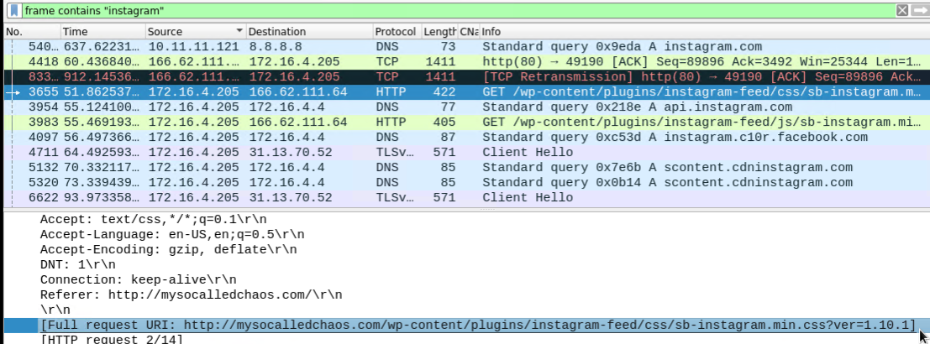
Social Media
Instagram.com traffic was observed (TCP, DNS, HTTP…)
Instagram feed plugin linked from http://mysocalledchaos.com
.

Slide 60
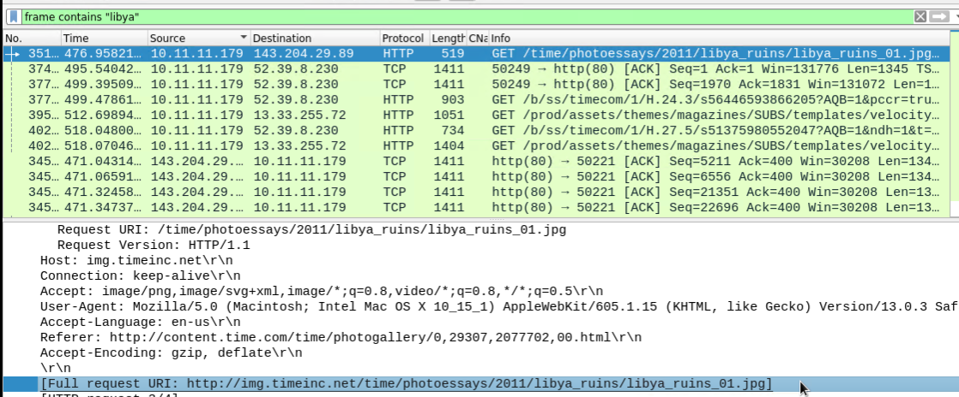
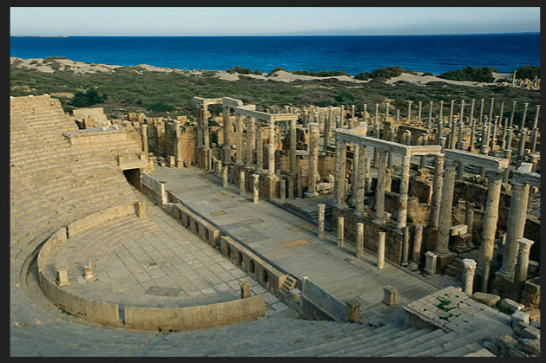
News/Research
Seemingly random news browsing/research was observed when filtering for HTTP and TCP traffic

Slide 61
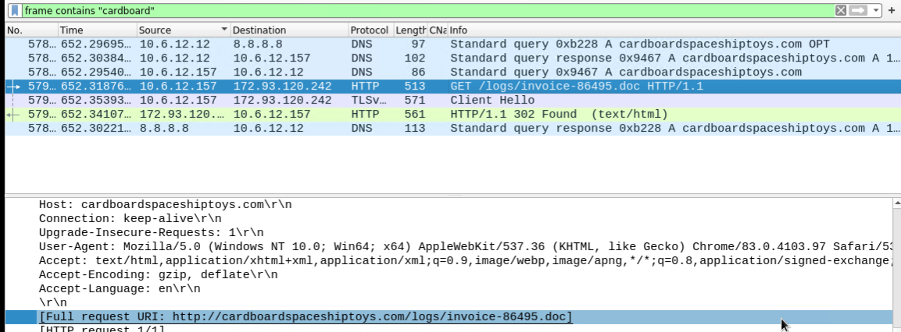
Shopping
Time wasting was observed when filtering for HTTP and TCP traffic
An invoice .doc was found from carboardspaceshiptoys.com

Slide 62
Malicious Activity

Slide 63
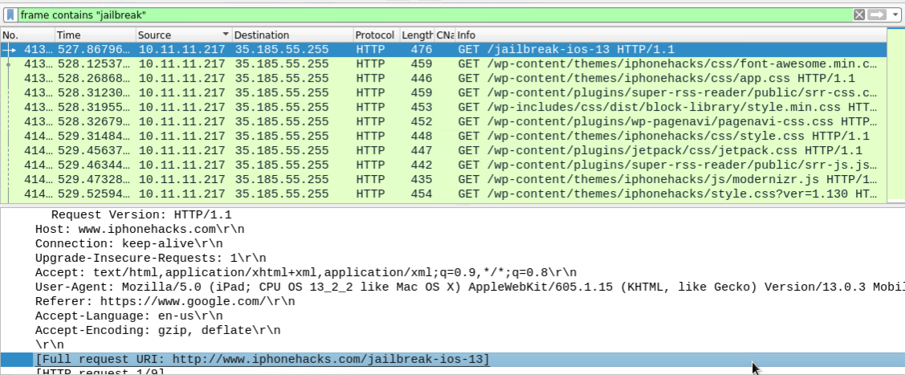

IPhone Jailbreak Research
User appears to have been researching how to jailbreak an IPhone (Protocol: HTTP)
Link to sites referring to “jailbreak” and “iphonehacks” shown below

Slide 64
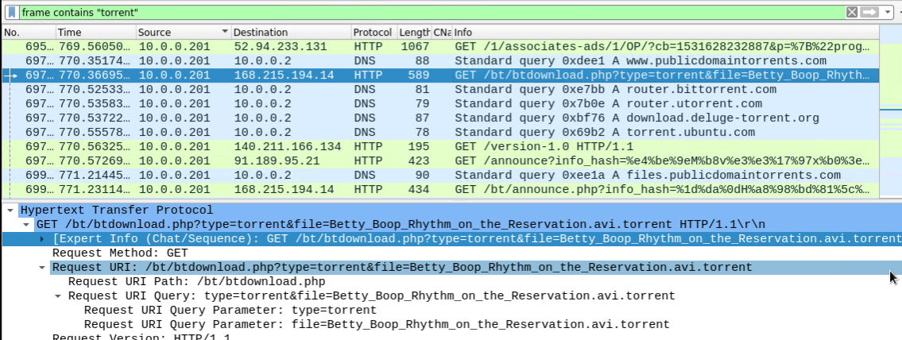
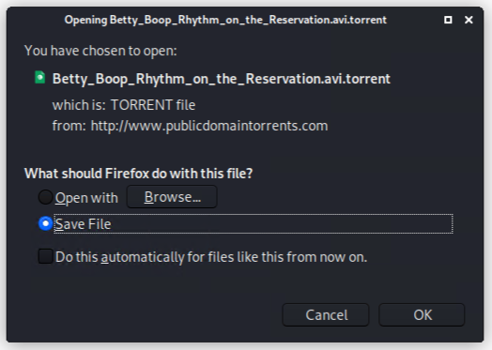
Bittorrent Download
A torrent file was downloaded from www.publicdomaintorrents.com
Torrent related traffic was found utilizing TCP, UDP, DNS, HTTP protocols
File was a Betty Boop cartoon video file

Slide 65
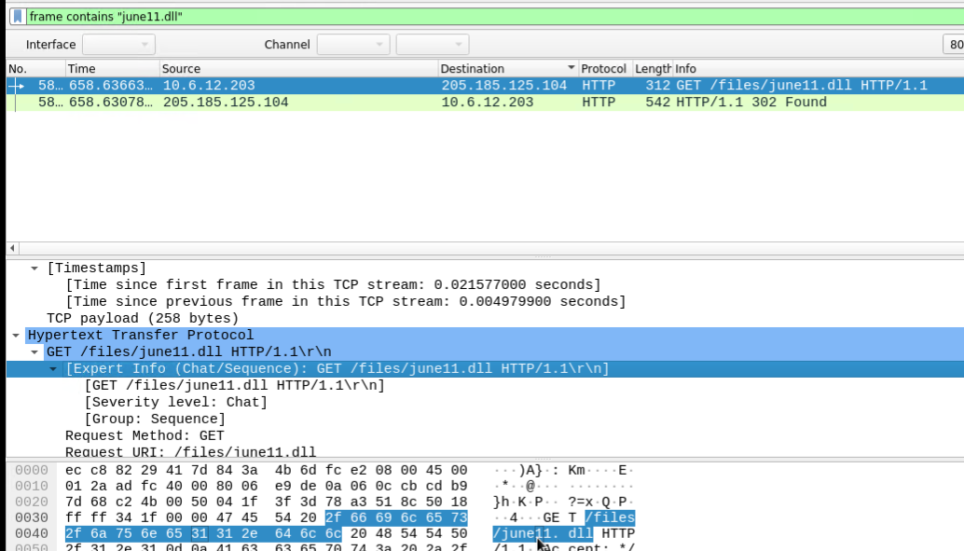
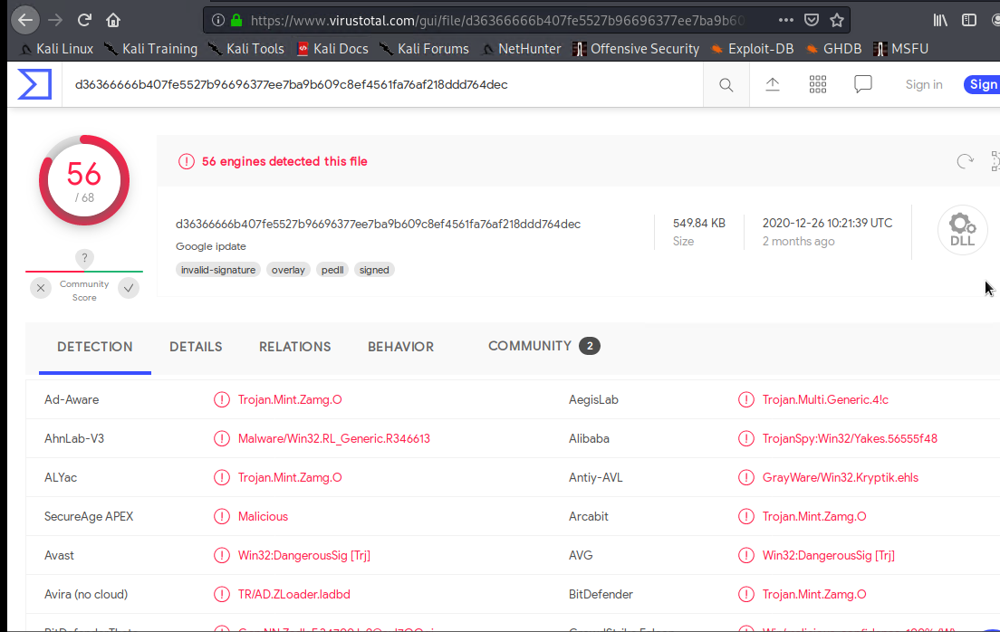
Malware Download
A malware trojan file was downloaded (HTTP)
File was identified as june11.dll and exported for analysis
Upload to virustotal.com revealed that this is in fact a trojan malware file

Slide 66
The End

